Slide 1
Schema and Instances
Lecture-3
-

Slide 2
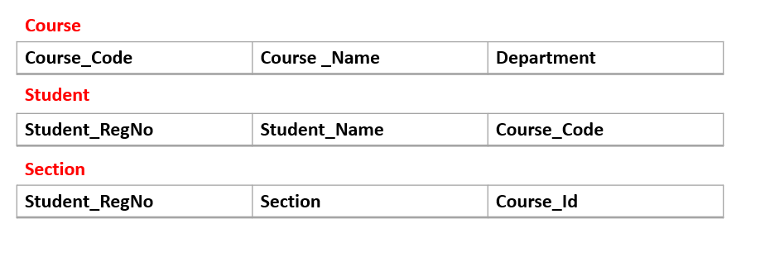
What is Schema
The term database schema can refer to a visual representation of a database, a set of rules that govern a database.
Rules and constraints to define the database
A database schema is a sketch of a planned database. It doesn’t have any data in it.
Important Point

Slide 3
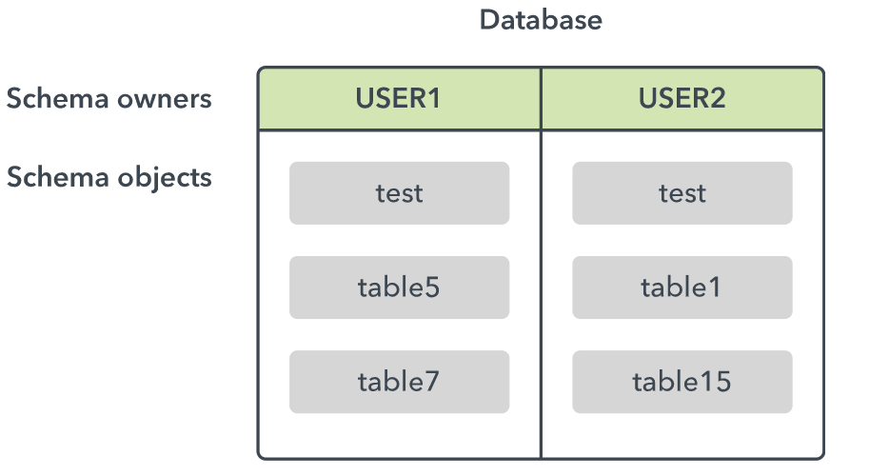
Oracle Schema

Slide 4

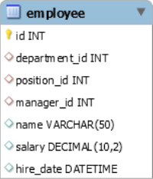

The figures shown, are examples of schema?

Slide 5
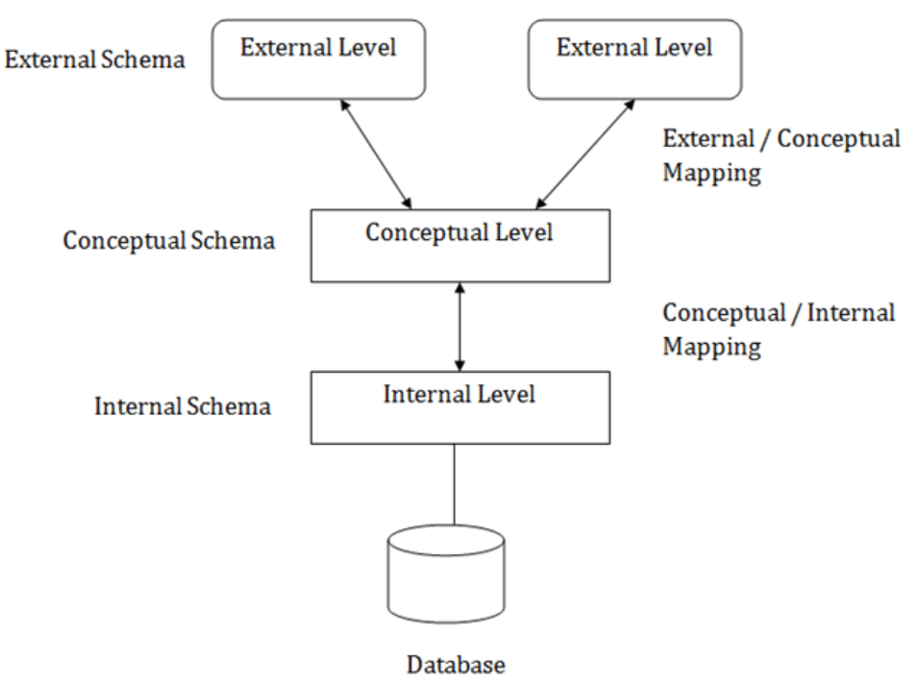
Three-level Abstraction of Schema
This gives rise to a term called Data Independence

Slide 6
Types of Schema
Star Schema
In it, one or more fact tables are linked to any number of dimensional tables.
Snowflake Schema
Snowflake schema is also used to represent a multidimensional database. It is a logical arrangement of tables in a multidimensional database such that the ER diagram resembles a snowflake shape.

Slide 7
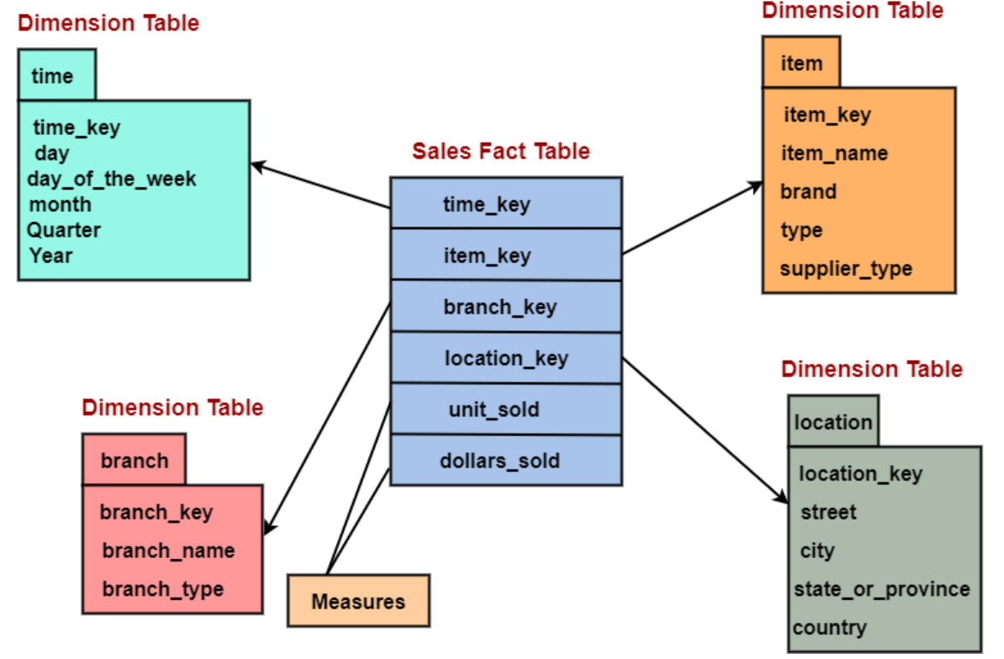
The above figure is an example of snowflake schema?

Slide 8
Instance of a Database
Database Schema and Instance are terms which are related to each other, but they do not mean same thing.
A database instance is a snapshot of a database that exists at an instance of time.
Thus, database instances can change over time, whereas a database schema is usually static.

